Slide 1
EXPORTING TO CANADA
FOOD & BEVERAGE
MIKE RICCIARDI

Slide 2
WHAT YOU NEED TO KNOW
Canadian Population: 38 million
Size: 9.9 million square miles
15,344 Grocery stores
Approximately 60,000 residents of Lithuanian descent
There are very few places in Canada where you can find authentic Lithuanian products, however, there are several stores that carry Northern and Eastern European products

Slide 3
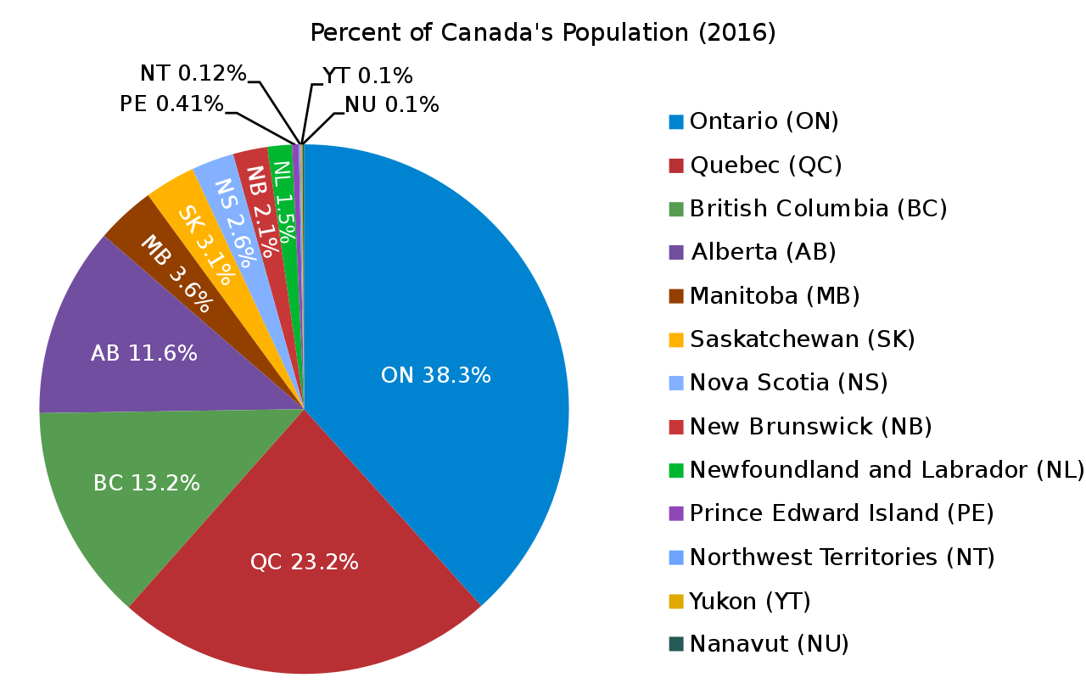
POPULATION BY PROVINCE

Slide 4
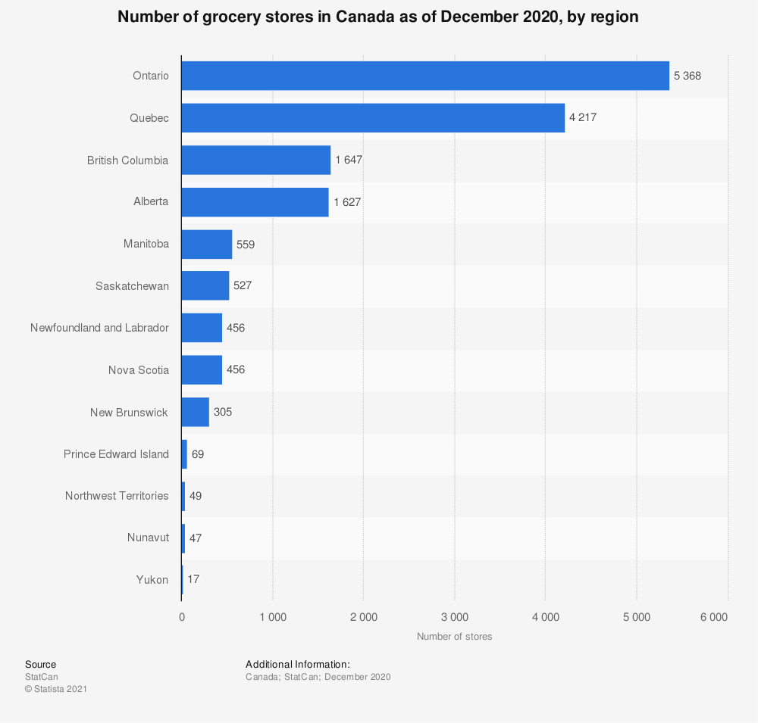
Canadian Grocery stores
BY REGION

Slide 5

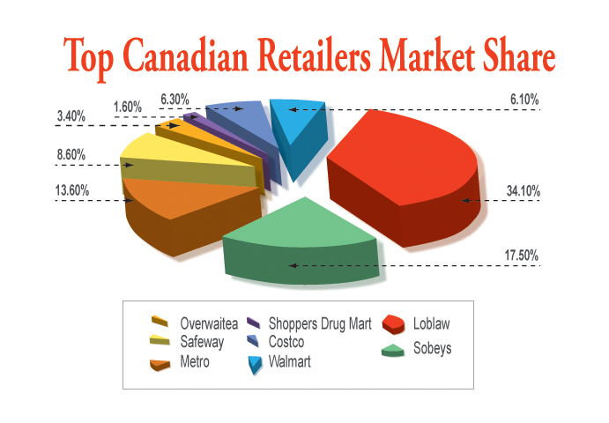



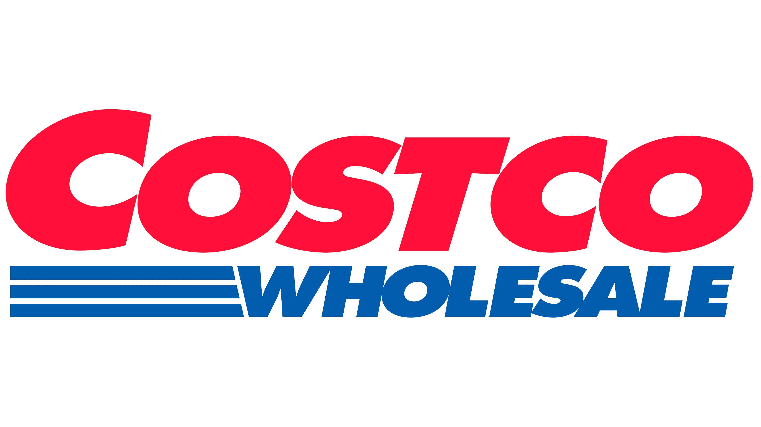


RETAILERS MARKET SHARE

Slide 6
REGULATIONS FOR EXPORTS TO CANADA
Before you consider exporting to Canada:
Ingredients: ensure that all ingredients are permissible in Canada
Labelling: all labels must be dedicated for the Canadian market. They must be bi-lingual (English and French) . There are several other requirements such as size of font and unit of measure must be in the metric system
Importer is licenced: as of July of 2020 all importers must have an Importers Licence number
Confirm all duties and taxes on your products. As an example, we had a situation years ago where a Mineral Water was duty free, but the Lemon and Lime flavoured ones were not
Review your pricing, if through a Market Study you discover that most of your direct competitors are on shelf at $3.99 for a product and you will end up at $4.99 with no added value or heavy investments in your brand, then you can figure out that your potential for success will be minimal
Find a suitable distribution method
Consider a Marketing strategy which will include strong social-media presence

Slide 7
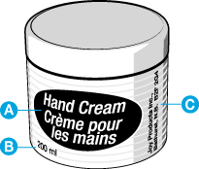
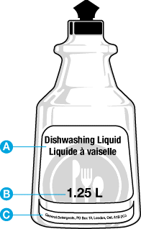
LABELLING
You will notice the same font in English and French
Measures are in the metric system
It is important to have a Canadian company assist you in preparing the labels. It has happened many times that a company prepared a package thinking that it would be approved, only to find out that it was not

Slide 8
DISTRIBUTION
Retailers are relying more and more on distributors
They are importing less directly, asking the Distributors to warehouse product for them so that they can draw product as needed. Most large retailers have stopped holding cases on their top shelf or in back rooms. They will simply order as needed

Slide 9
DISTRIBUTION CONT’D
Most Importers / Distributors are asking the producer to initiate some sales before they take on a product. Years ago, they would take your brand and introducing it in the country, now they want to ensure that there is some initial interest in the product line before they take the risk of Importing it

Slide 10
OTHER SECTORS
Retail will probably make up most of the opportunities for your product ranges, however, there are other opportunities:
Food service & Hospitality: Restaurants, Hotels, Casinos, Trains, Planes, Hospitals, Retirement Homes
Online
Processors: raw ingredients

Slide 11
Q & A
Opportunities for Honey: This is a product that we consume volumes of, so there is an opportunity. However we need to see if there is anything different (quality, flavours, prices) about yours in order to determine if can have success. Organic (BIO) would have a better potential to succeed
Mineral water: easy to approve but we would need to check things such as “arsenic” levels etc.. In Canada (as in most countries) water is a product that needs high volume sales in order to be profitable, unless it’s unique
Which Lithuanian products have a chance to succeed in Canada. There are two ways to answer this: first would be the more known products, such as: Potato dumplings, Cold Beet soup, Potato pancakes etc.. Then we could see which product could become popular (this we do by conducting focus-groups)

Slide 12
Q & A CONT’D
Latest Trends: Organic products continue to be popular, as well as healthy foods, but Frozen Foods are picking up the most momentum. Maybe driven by the COVID situation and people that are home more now, want good products that they can access easily without having to go to a store. This is also something that we address in our Market Study
How to start trade relationships independently: You can simply contact buyers directly, the problem is that they want you to be fully prepared to give them product that is approved for their shelves, as well as having their supply-chain covered. For the most part, these are products that will need to be sold by the case or pallet, therefore for getting authorized product to Canada and for having a warehousing and distribution system in place, it is highly recommended that you partner with a Canadian broker, importer etc.

Slide 13
Q & A CONT’D
Wholesale Platforms: there are several Wholesaler options, but just as a Distributor would ask of you, these wholesalers want to know how you plan to market your product so that customers will buy the product from them
Canada / USA: should definitively be treated separately. They have different sets of import rules, labelling etc.…We conduct Market Studies and prepare you for both countries
Frozen Fish Market: Frozen fish is a very important category. I am actually working on the category with a major Importer/Distributor

Slide 14
